Slide 1
Categorical Car Crashes
IOD Mini Project 2
Ciaran Mathewson
New York, Monroe County Data Source – US Data.gov database: https://catalog.data.gov/dataset/traffic-data
Notes:
Hello again! As this Mini-Project was mainly on categorical data, I selected New York traffic collisions data set. It’s fairly simple with temporal data of days, months, years and some categorical variables like weekend or not, injury type and vehicle collision type.

Slide 2
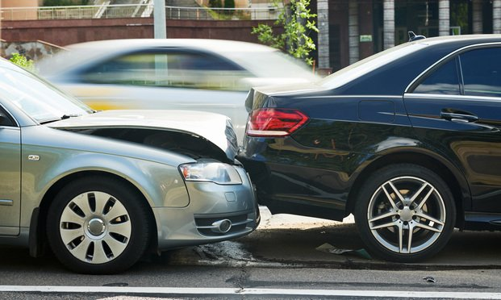
Agenda
Background
1
What are the costs of car crashes?
Pipeline
2
What processes are used?
Business Question
3
What are we trying to achieve?
Data Analysis
4
How do the models compare?
Conclusions
5
What more can be done?
Notes:
Here’s a rundown of what we’ll go through in the next 5 minutes

Slide 3
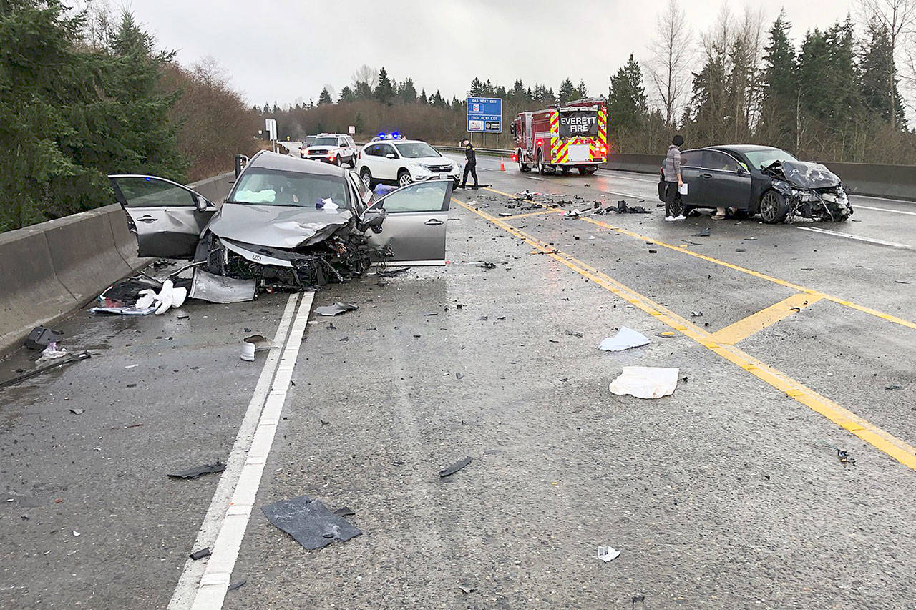
Background - Damages
US traffic accidents cost $871 billion/year
$277 billion in economic costs
$900/person of the whole US population
Property damage
Insurance payouts
$594 billion in quality of life costs
Loss of life
Injuries both immediate and ongoing
Costs due to injury double the economic costs
Notes:
Car crashes can be catastrophic. The damages of traffic collisions are enormous. As my dataset covers 2003 through to 2015, by using a 2014 study the damages are estimated at $871 billion per year. The injury costs are more than double the economic costs, so injuries are what must be analysed, and predicted.

Slide 4



Pipeline
Business Question
Data Collection
Comparisons and Further Directions
Results Analysis
Data Manipulation
Modelling
EDA & Visuals
This Photo by Unknown Author is licensed under CC BY-NC
This Photo by Unknown Author is licensed under CC BY-NC
This Photo by Unknown Author is licensed under CC BY-NC
Notes:
How do we go about this? The pipeline is a little more interesting this time. Start with Business question, collection, data manipulation (missing values, feature selection), then visualisations to see what kind of data we have, then modelling. Ineffective models will still be analysed to gain insights, however generally won’t be further pushed. Instead the data will be manipulated to recover more meaningful EDA, and thus another model.

Slide 5
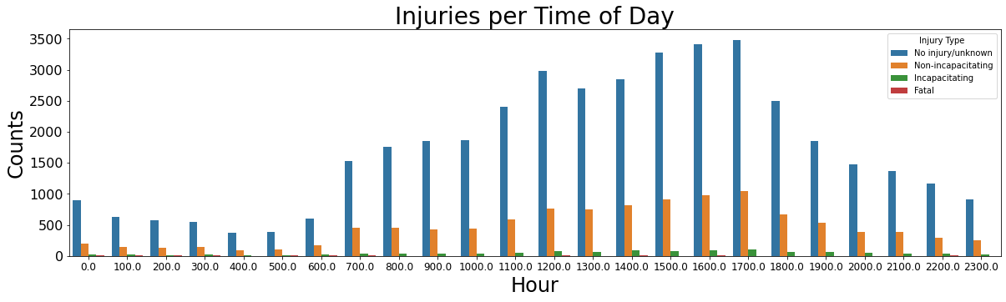
Business Question
Costs due to injury are greater than costs of the crash itself
Can we save costs and necessary manpower by predicting when a crash has a high likelihood of causing injury?
Data Question: Which modelling techniques give the best prediction of injury under specific circumstances?
Notes:
Read slide ------- One example to explain this better: if a particular time of day is more likely to have injurious crashes, like the trend we can see in this hourly graph, make sure the payroll includes a larger number of emergency staff in those hours. Especially in this time of COVID, shift hours are more and more important. Data question ----

Slide 6
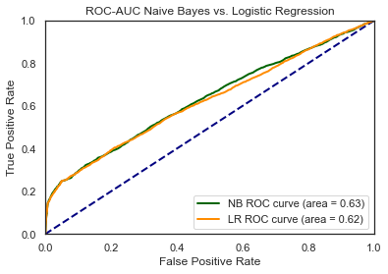
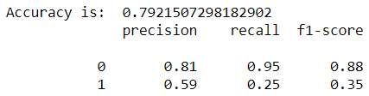
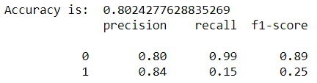
Data Analysis – Model Comparisons
Naïve Bayes
Logistic Regression
Naïve Bayes is the ‘better’ model
False Positive (precision) is an economic cost
False Negative (recall) is a quality of life cost
Model with highest recall is ‘better’
Notes:
Here’s my one technical slide. Two main models, Naïve Bayes and Logistic Regression. ROC of 0.63 best I could get, accuracy at 80%.
Differences lie in precision and recall. For this business question, a false positive result is an economic cost (sending a team out for an injury when there is none), whereas a false negative is a quality of life cost (sending no emergency crew when there is actually an injury).
QoL costs double economic, so we do not want QoL costs.
In this case, the Naïve Bayes model is the better model to use, as recall is higher. Naïve Bayes is also the better model in this case, as Naïve Bayes treats all variables as independent of each other, which they are between individual crashes.

Slide 7

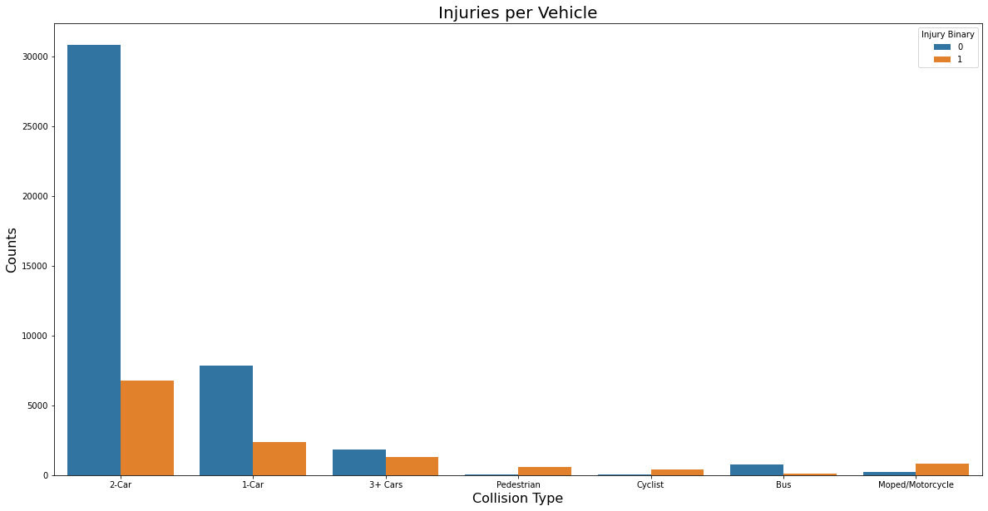
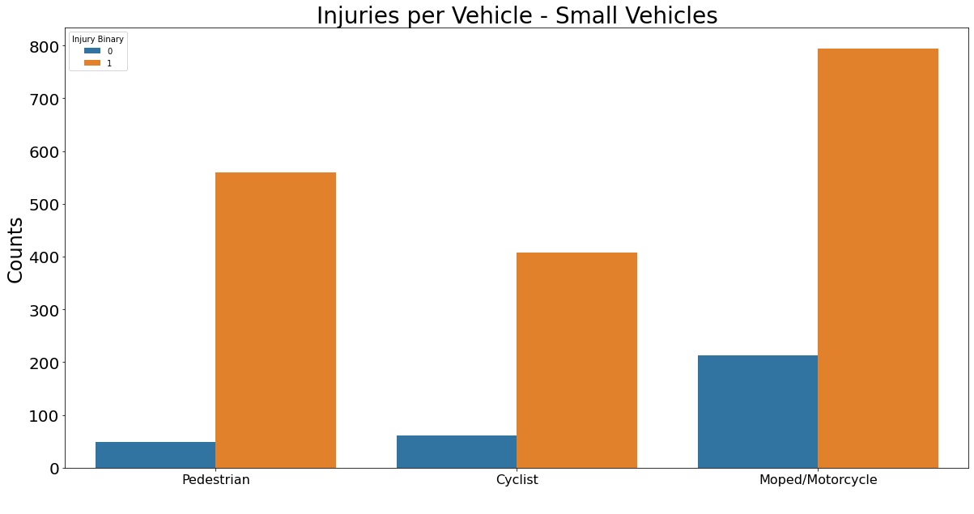
Data Analysis - Metrics
The most important metric is Collision Type, which changes considerably for how many injuries occur when there is a collision
Notes:
As the models are useful but not ideal, we must return to the EDA for the more valuable insights. As to metric comparisons, when it comes to injuries themselves, collision type is the most important.
Most collisions are 2-car collisions, largely above the rest.
Note that for small transport methods, nearly every collision results in an injury, by a considerable margin.
CLICK
This makes collision type even more important, as it directly corresponds to an injury from a collision.

Slide 8

Conclusions
Useful model, but not ideal
High amount of FN is poor
Collision Type is the most reliable metric
Small vehicles/pedestrians the most injured
Improvements
Split injury data into four groups
No injury, non incapacitating, incapacitating, fatal
More physical road data,
Road type, weather data
Notes:
From this particular model used with this particular dataset, it is useful, but not ideal. A high amount of false negatives is quite poor. Metric comparisons highlight collision type as the highest metric. There are many improvements to this dataset, and I continued with it both as an exercise in modelling categorical variables, and how to identify whether datasets need more features, rather than finding a dataset that immediately leads to a good model. I converted injury type to a binary variable, but perhaps a better result could come from keeping the original four groups, no injury, whether its incapacitating or not, or fatal. Also, there are far more features to include in different datasets, for example whether roads are sealed or not and the weather conditions at the time.

Slide 9
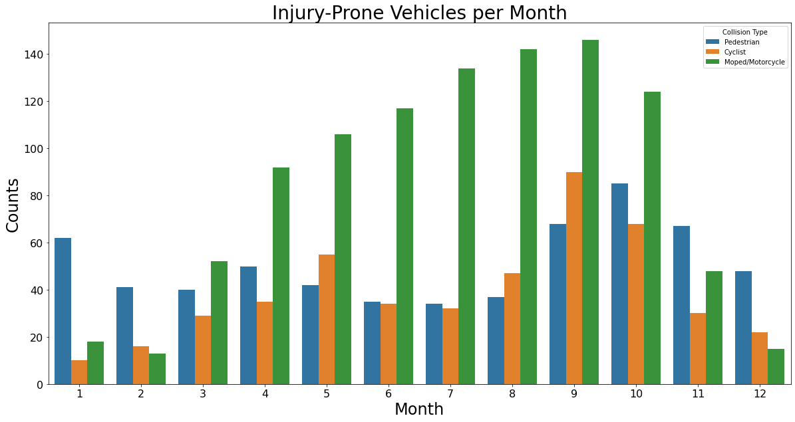
Further Directions
Modelling time series data can highlight temporal trends on a larger scale
As injuries are such a high chance in small vehicles, take all collisions over a long time frame
Notes:
As for further directions, … … … …
Perhaps injuries themselves aren’t the best predictor. Collisions in general opens up the scope more, so could gain better predictions.
You can see here that motorcycle accidents around summer, cyclists at the end of summer (too hot to cycle perhaps), and pedestrians peaking at the start of winter. Would slipping over on ice count?

Slide 10
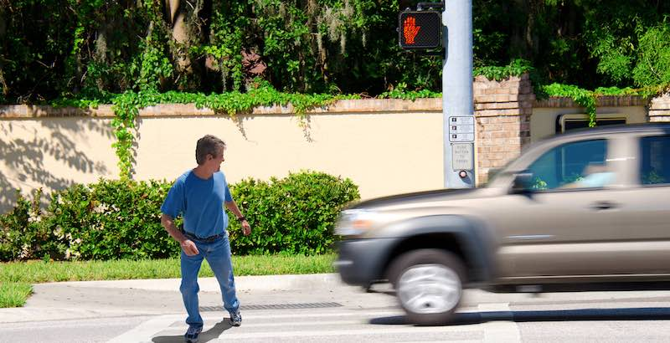
Questions?

